Slide 1

Netflix Dataset Analysis - Content Trends Analysis for Strategic Recommendations
Boda Priyanka
INTERNSHIP_17546440516895be537820f

Slide 2

PROBLEM STATEMENT
Netflix has become one of the most prominent global streaming platforms, continuously expanding its library with a mix of original productions and licensed content. However, with growing competition from platforms like Amazon Prime, Disney+, and regional OTT providers, Netflix must strategically analyze its content catalog to identify strengths, gaps, and opportunities.
The specific problem to be addressed in this project is 'Content Trends Analysis for Strategic Recommendations'. The aim is to uncover how Netflix’s content distribution (Movies vs. TV Shows, genres, and country contributions) has evolved over the years. This will enable the identification of key genres, audience preferences, and strategic insights into global content expansion.

Slide 3
Project Description
This project analyzes Netflix’s Movies and TV Shows dataset (7,789 records, 11 columns).
Focuses on understanding content trends over the years (2008–2021).
Key data points include:
Title, Director, Cast
Country of origin
Release year & Date added
Type (Movie / TV Show)
Duration and Genre
Goals of the analysis:
Compare Movies vs. TV Shows over time.
Identify popular and underrepresented genres.
Evaluate country-wise contributions to global content.
Provide strategic recommendations for Netflix’s content strategy

Slide 4

WHO ARE THE END USERS?
Netflix Content Strategists & Analysts
To understand which content types perform best and plan acquisitions.
Marketing & Regional Teams
To tailor campaigns based on country-wise preferences and trends.
Data Analysts & Researchers
To explore viewing trends, genre popularity, and content gaps.
Business Decision Makers
To make informed decisions on content investment, production, and global expansion.
OTT Competitor Benchmarking Teams
To compare Netflix’s content library against competitors like Amazon Prime, Disney+, etc.

Slide 5

Technology Used
Python – Main programming language for data analysis.
Pandas – Data cleaning, manipulation, and aggregation.
NumPy – Numerical computations and handling missing data.
Matplotlib & Seaborn – Static data visualizations (bar charts, line plots, heatmaps).
Plotly – Interactive visualizations (line charts, choropleth maps).
Google Colab – Interactive environment to write, test, and document the analysis.
Scikit-learn (Optional) – Clustering analysis using TF-IDF and KMeans on content descriptions.
Excel / CSV – Input data storage format.

Slide 6
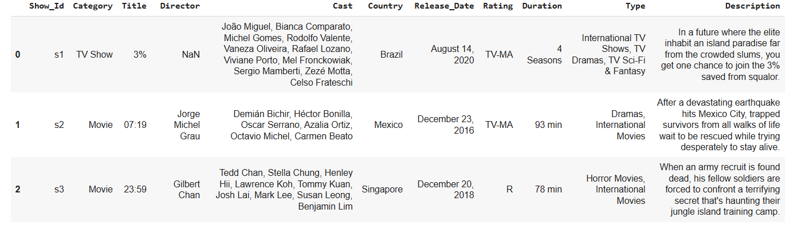
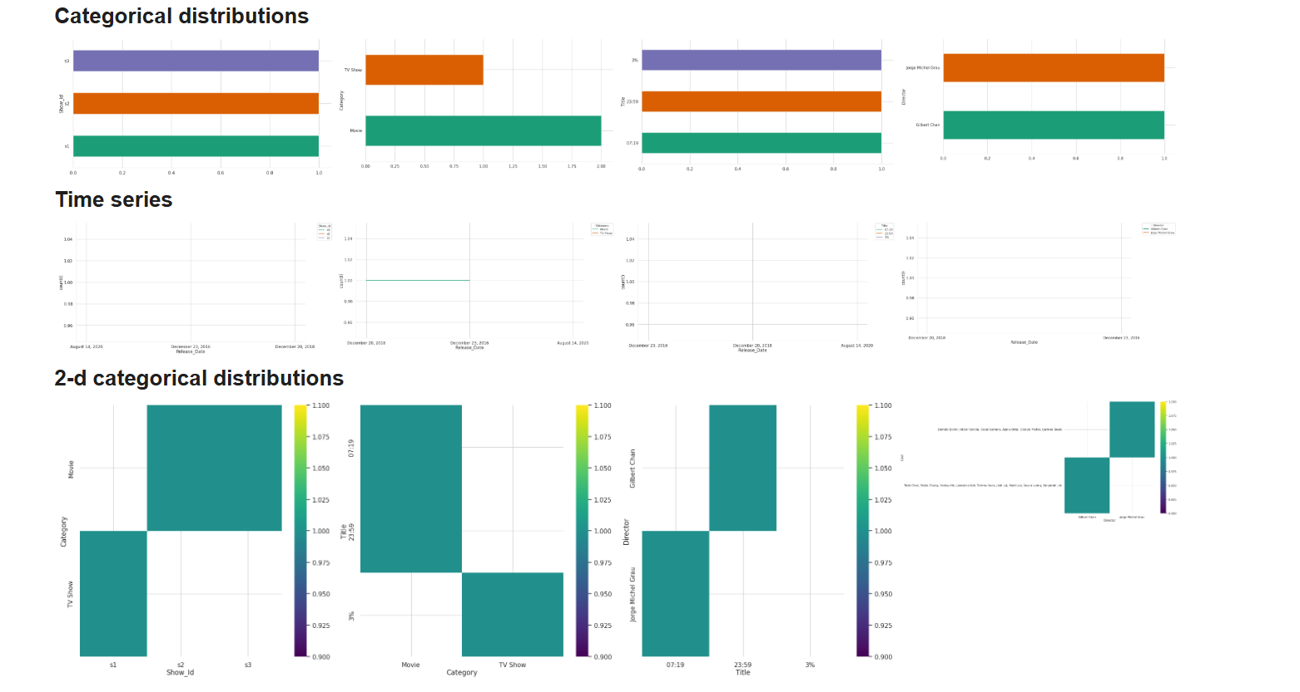
RESULTS1

Slide 7
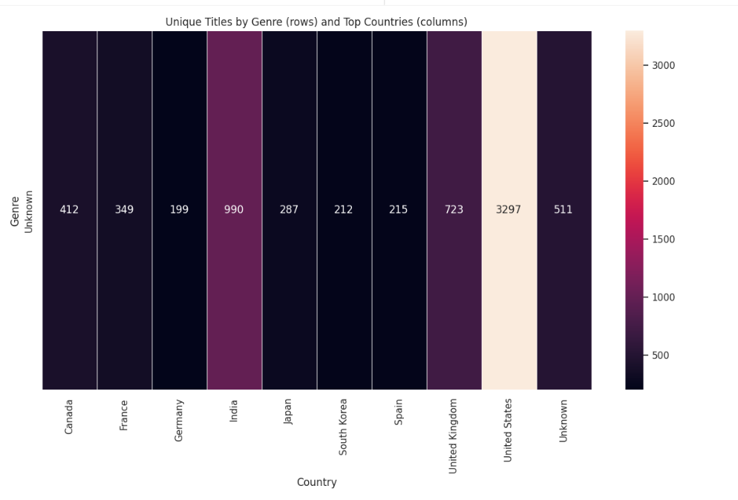
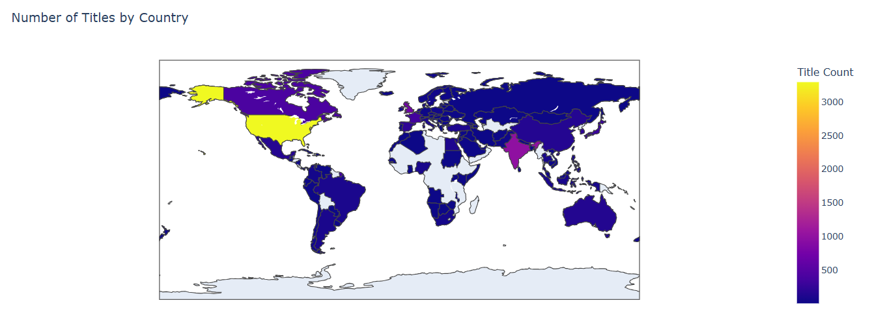
RESULTS2

Slide 8
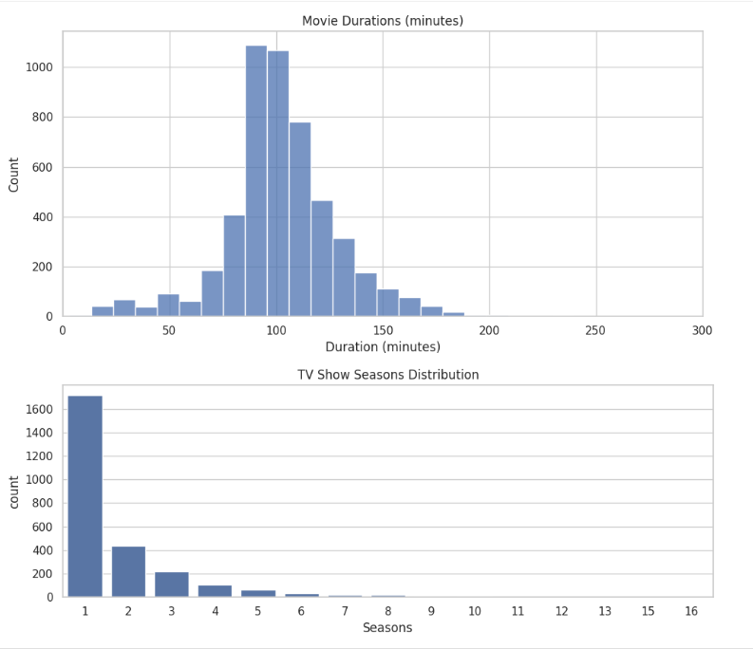
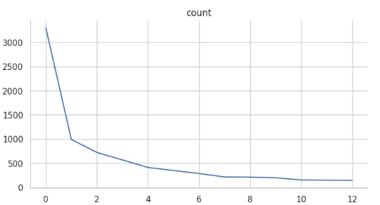
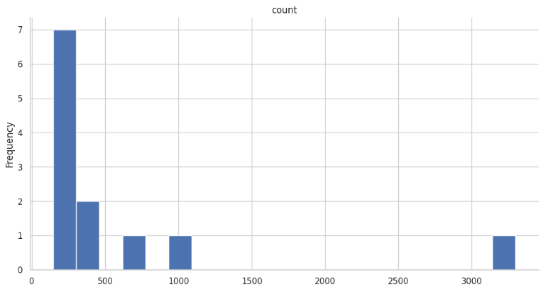
RESULTS3

Slide 9
GitHub repository
[Add the working url of your github repository ]
Create github repository with format VOIS_AICTE_Oct2025_MajorProject_YourName

Slide 10

Getting started with Basics of Python Certificate

Slide 11
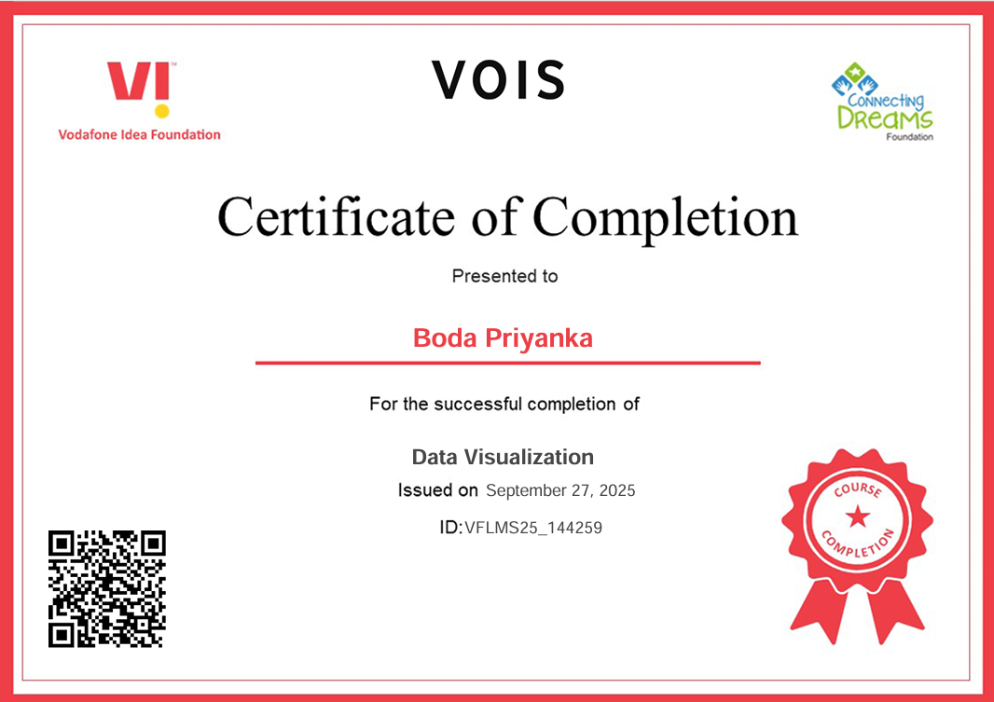
Data Visualization Certificate

Slide 12
Thank you
.
.

